Slide 1

Y6 Parents’ Meeting
9.9.26

Slide 2
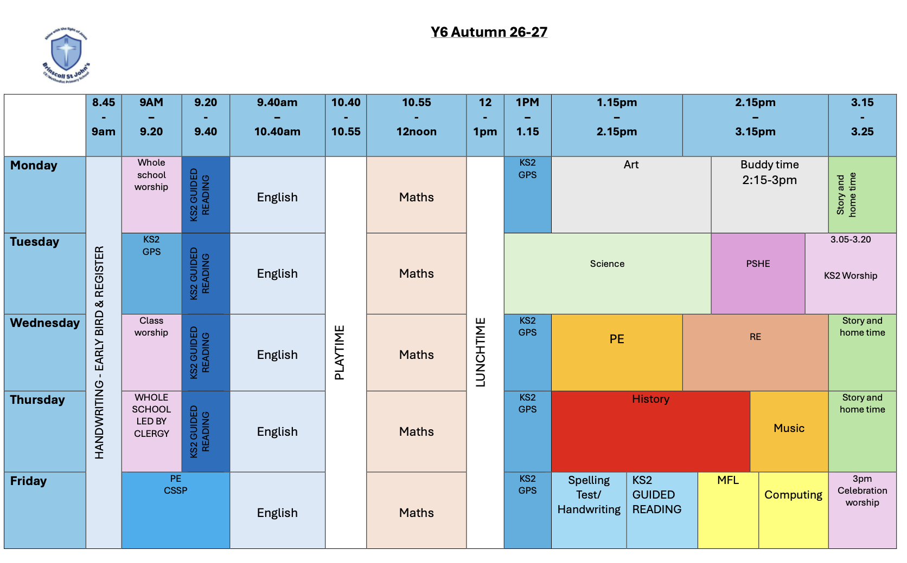
Timetable
Roughly the same subject time allocations as previous years.
Mrs Savage Tue pm
Additional slot for work with buddies/nursery on Monday afternoons
s

Slide 3
Buddies/nursery
Each child has a buddy – but there’s 31 of us and substantially less of them, so we are sharing.
We started the nursery visits last year – this seemed to be popular and positive for both our children and Nature Trail’s, so we arel continuing it this year.
Each Monday, children will visit their buddies. Each week, they will have a different activity or job to do.
Nursery visits will be on a rota and children will go roughly every 6 weeks.

Slide 4
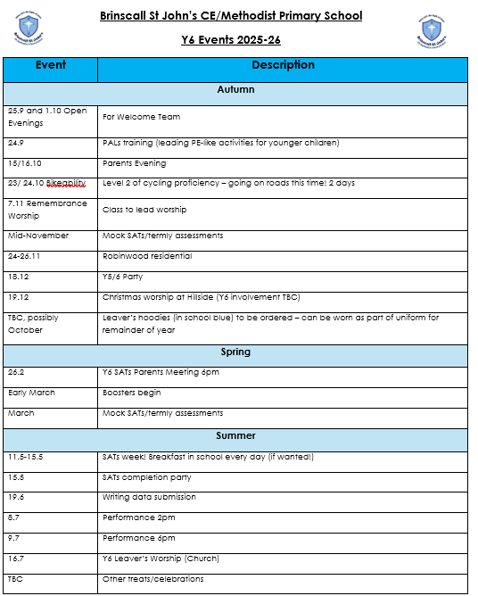
The overall year
Emailed out on during the first week with the newsletter.
This is what we know currently but as you will be aware the school calendar fills up as we move through the year so keep an eye on the newsletter and website for more updates.
One for your diaries…
Y6 Class Worship- 2nd Oct

Slide 5
SATS
External examinations
Children assessed in Reading, Writing, Mathematics and Grammar, Punctuation and Spelling (GPS)
We will have a parents’ meeting in February as they get nearer
We will be practising SATs-style questions in small doses throughout the year
We do NOT want them to completely dominate the last year of school! While we will do everything we can to promote the best outcomes for all children, we also want them to have a broad curriculum and a positive final year of primary.

Slide 6
Boosters
Every child will be offered a session – some will be before school, some after, some during. This will depend on staffing availability and how the children are grouped.
These will target certain topics/areas and will be informed by the mock SATs we do in school.
They are not mandatory.

Slide 7
Homework
Y6 will complete the CGP study books.
These will be starting soon.
Each week, children will be asked to complete a task in each book
These will be marked together in class on a Friday

Slide 8
Residential – Robinwood
This will be a first for me in NOVEMBER!
Scarily, I went there on my own Year 6 residential.
According to last year’s Year 6, it:
  Is “Well good.”
  Is “Way better than that place you took us.”
  Has “proper food.”
  Allows you to “Do well fun stuff, like loads more than that other place, we loved it.”
  And Mrs Owen said 'The food is delicious; the children are excited and loud on day one and then exhausted and ready for bed early on day two!
In pack - (sample?) menu, parents info, child code of conduct, packing suggestions, what activities develop, etc.

Slide 9
Performance
We will select a performance after Christmas
The children will get the scripts and be allocated roles post-SATs
I will do my very best to try to balance roles and give everyone a chance to shine
Everyone will take part, but if musical theatre is not your thing (which I definitely understand) then smaller roles can be arranged
Any help with choreography, etc. from anyone experienced (or just enthusiastic about!) musical theatre would be welcomed!

Slide 10
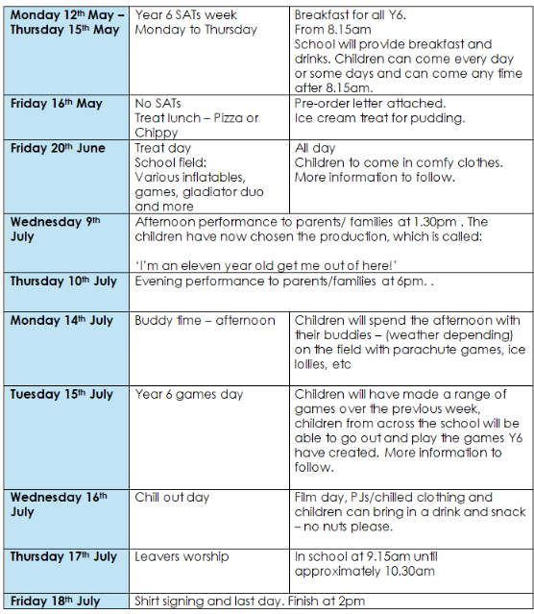
End of year celebrations
We will have a party when SATs end
There will be other events organised in the latter half of the year – last years’ is here
Happy to do something similar, happy to do something else – but trips are very costly and hard to get at that time of year!
A letter will be sent with final details around April.

Slide 11
Things I want to ask you
Pictures for leavers’ service
Contributions to end-of-year celebrations
Mock Sats results

